Slide 1

Requirements-Driven Online Adaptation to Mitigate Runtime Uncertainty for AUSs
Yixing Luo
yixingluo@pku.edu.cn
Software Engineering Institute
School of EE & CS, Peking University

Slide 2
1
CONTENT
Introduction
目录
2
Motivating Scenario and Problem Statement
3
Approach
4
Implementation in UAV delivery scenario
5
Experimental Evaluation
6
Related Work
7
Conclusions and Future work

Slide 3
1
Introduction

Slide 4
Introduction
Autonomous Unmanned Systems (AUSs)
Recent decades have witnessed a dramatic growth of Autonomous Unmanned Systems (AUSs) which have the ability of function independently with out human interaction.
However, without a human pilot onboard, AUSs are required to overcome unexpected situations as small mistakes can lead to catastrophic and dangerous results to the environment
Historically, numerous accidents and crashes have occurred (examples). Thus, AUSs should not only handle requirements related with its functionality, but also be environmental-friendly.
Runtime Uncertainties
The control software is responsible for controlling the behaviors of AUSs to complete given tasks, as well as satisfying different requirements
Whereas, during operation, the control software of AUSs required to handle conditions that were not expected at the time when the system was developed.
The effects produced by unpredictable conditions can compound and thereby inhibit the system from fully satisfying its requirements.

Slide 5
Introduction
Self-adaptation mechanism
To address real-time uncertainties and ensure requirements satisfaction for AUSs, self-adaptation might be a useful strategy for the design of the AUS control software.
Goal-driven adaptation: To support explicit expression of environment uncertainty in requirements for self-adaptive systems, RELAX was developed. (only applied to specify the extent to which non-invariant functional requirement may become temporarily unsatisfied——violation of environment-centric non-functional requirements?)
Control-based adaptation: Control theory provides the possibility for designing robust self-adaptive systems with formal guarantees. Methods to control the lower-level elements, and general and automated are proposed.
(Seldom considering of trade-offs between requirements, which leads to a lack of guarantee for optimality of solutions when handling multiple requirements.
Merely consider runtime performance to maximize the satisfaction of multiple requirements.)

Slide 6
Introduction
Control-based requirements-driven adaptation mechanism (Captain)
To make the AUSs more environmental-friendly and earn the trust from users, we elicited and model the requirements reflecting system performance and capabilities, and environment-centric requirements like safety.
Considering of the runtime uncertainties, we set up requirement satisfaction model to evaluate the achievement of requirements online.
To guarantee the optimality of requirement achievement and real-time performance of AUSs during the online adaptation process, we introduce a three-stepped mechanism in \tool based on control theory to monitoring, evaluating and managing multiple usually conflicting requirements: Requirement Satisfaction Checking, Requirement Satisfaction Analysis, Requirement Satisfaction Optimization.
The adaptation space is reduced as only requirements which predicted cannot be satisfied are transformed into objective functions to optimizes their satisfaction.
Simulation results show that it outperforms state-of-the-art control-based solutions (e.g., AMOCS-MA) in dealing with multiple requirements for motion and configuration planning in complex environments. The effectiveness is also demonstrated in completing real-world missions.

Slide 7
Introduction
Contributions
方法(high-level, 特征，规约过程)
特殊的地方
(1) Non-functional requirements for AUSs to meet are elicited and modeled both from system and environment perspective. In addition, a requirement satisfaction model is established for runtime evaluation
(2) A three-stepped control-based adaptation mechanism for requirement monitoring, evaluation and management while guaranteeing optimality and real-time performance.
(3) A real-time and multi-objective planner which allows sensor reconfiguration and motion planning of AUSs simultaneously.
Organization of this paper

Slide 8
2
Motivating Scenario
and Problem Statement

Slide 9
Motivating Scenario
Exciting applications for UAV
Since Amazon announced its drone delivery plan “Amazon Prime Air” in December 2013, drone delivery starts its countdown on the commercial usages.
Alphabet's Wing launched its inaugural commercial drone air delivery trial in October 2019 and become the first company to provide drone delivery services in United States.
Challenge:
However, drone delivery services are still in their infancy. Most of the people do not support this idea of drone delivery as they are concerned about the safety, privacy, and environment issues.
To get permission for commercial usage of drone delivery in near future, besides of functional requirements which ensure the mission is complete, non-functional requirements for the system to met should not only consider system performance, but also environment-centric requirements.

Slide 10
Motivating Scenario
Challenge:
It is challenging for AUSs to handling those multiple requirements online, since changes and uncertainty in the environment and system may cause conflicts between requirements and results in requirement violations.
The delivery task is not trivial because the system has to operate in an environment that is subject to uncertainties

Slide 11
Problem Statement
Problem Statement
To mitigate runtime uncertainties in the operating environment of AUSs, the satisfaction of requirements elicited and modeled from the perspective of environment and system should be evaluated effectively so that an adaptive solution is figured out to guarantee the optimality of overall requirement satisfaction.

Slide 12
3
Approach

Slide 13
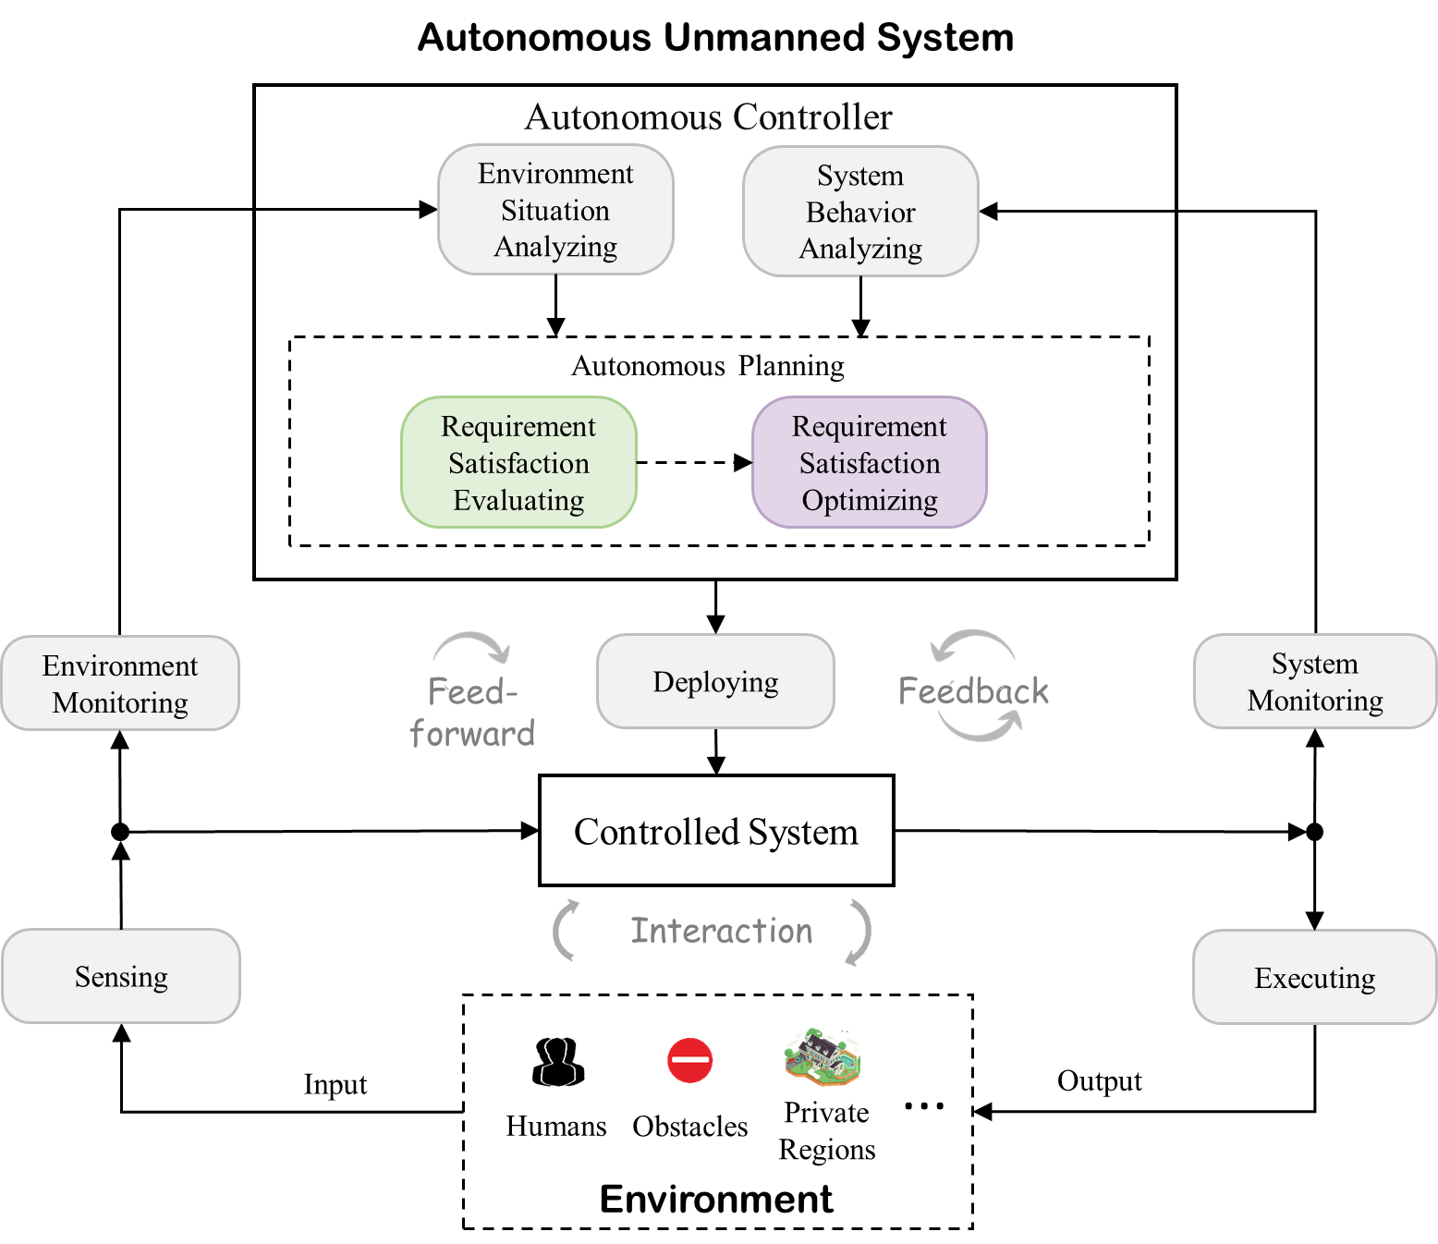
Overview

Slide 14
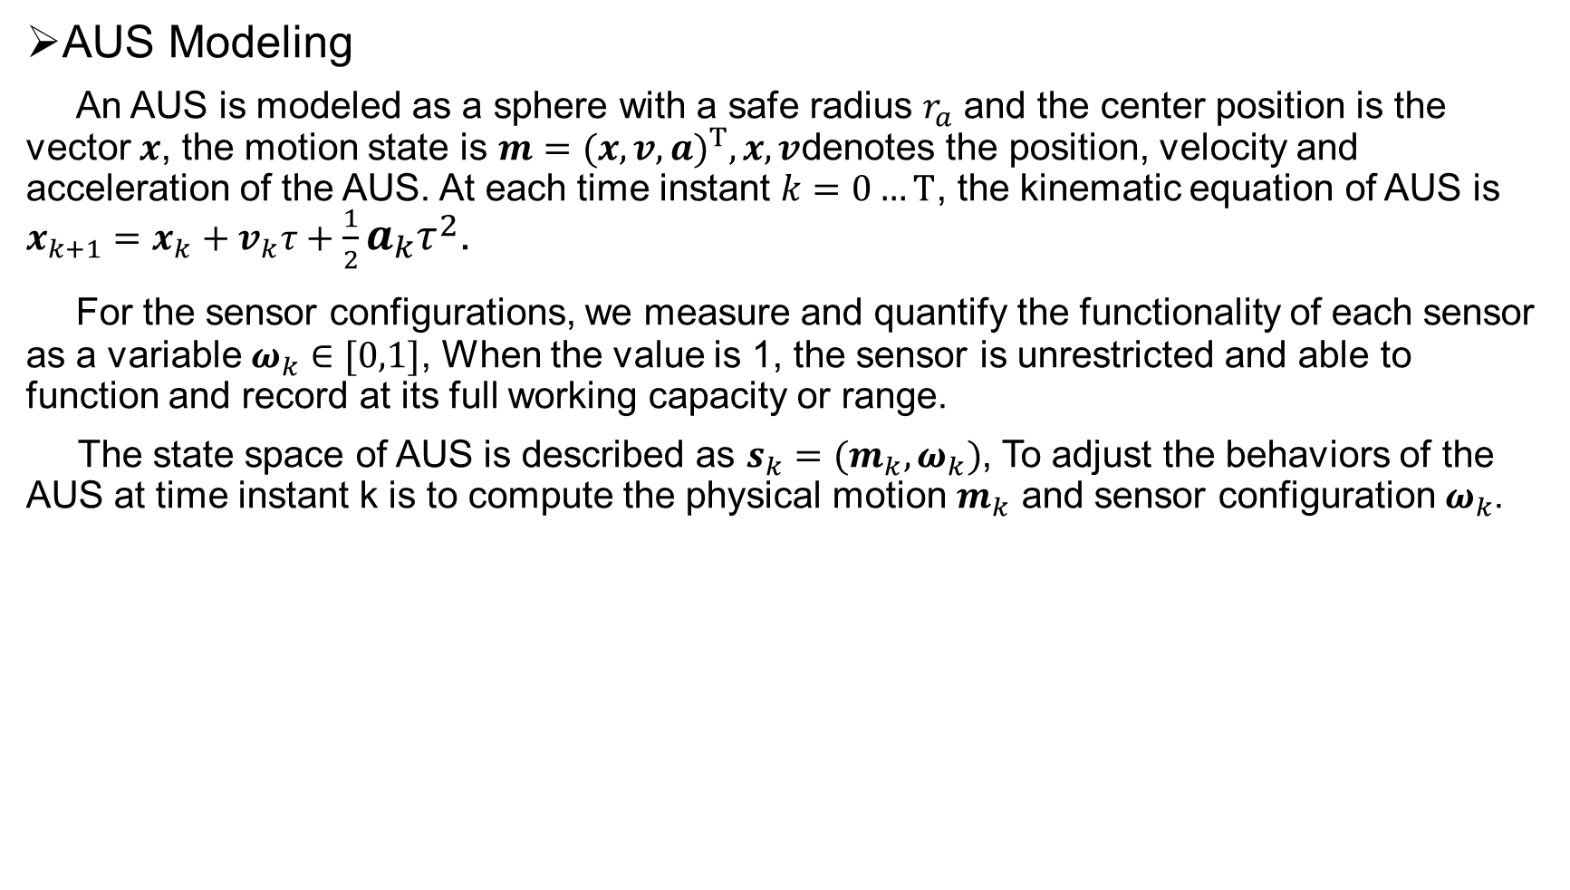
Modeling
AUS Modeling
An AUS is modeled as a sphere with a safe radius $r_{a}$ and the center position is the vector $x$, the motion state is $m={(x,v,a)}^{T},x,v$denotes the position, velocity and acceleration of the AUS. At each time instant $k=0…T$, the kinematic equation of AUS is $x_{k+1}=x_{k}+v_{k}τ+\frac{1}{2}a_{k}τ^{2}$.
For the sensor configurations, we measure and quantify the functionality of each sensor as a variable $ω_{k}∈[0,1]$, When the value is 1, the sensor is unrestricted and able to function and record at its full working capacity or range.
The state space of AUS is described as $s_{k}=(m_{k},ω_{k})$, To adjust the behaviors of the AUS at time instant k is to compute the physical motion $m_{k}$ and sensor configuration $ω_{k}$.

Slide 15
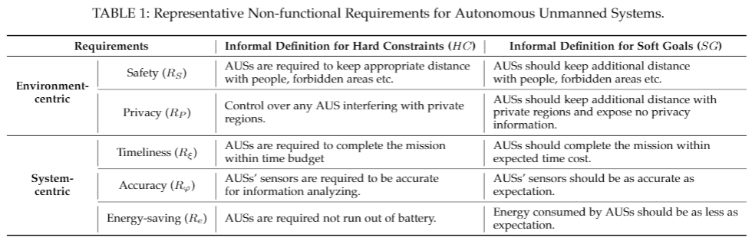
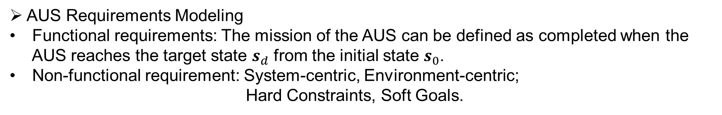
Modeling
AUS Requirements Modeling
Functional requirements: The mission of the AUS can be defined as completed when the
AUS reaches the target state $s_{d}$ from the initial state $s_{0}$.
Non-functional requirement: System-centric, Environment-centric;
Hard Constraints, Soft Goals.

Slide 16
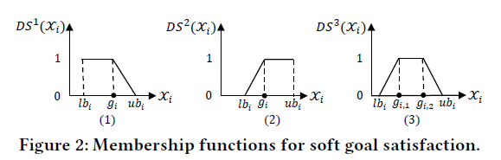
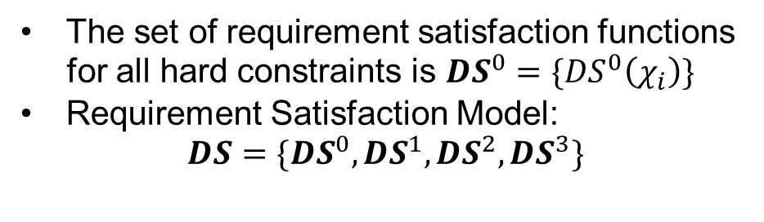
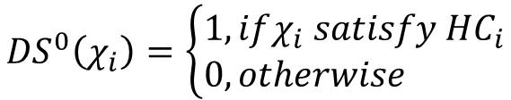

Modeling
Modeling Requirement Satisfaction
Let $χ$ be the Quantification Measure (QM) for a requirement in requirement set $R=HC⋃SG$. It is defined as a function of the system’s observations, i.e., $Ob$, which includes its states 𝑠 and the detected environmental conditions ($𝒪,𝒞$). Its value at time instant 𝑘 is denoted as $χ_{i}(k)$ for the evaluation of the requirement $R_{i}$
Requirements are into two sets, i.e., $R_{M}$ contains the requirements to maintain, that must always be satisfied by the system-to-be. While $R_{A}$ contains the requirements to achieve at the end of the missions ($R=R_{M}∪R_{A}$)
Satisfaction model for soft goals and hard constraints
$${DS}^{0}\left(χ_{i}\right)=\left\{\begin{aligned}1,&ifχ_{i} satisfy {HC}_{i} \\ 0,&otherwise\end{aligned}\right.$$
The set of requirement satisfaction functions
for all hard constraints is ${DS}^{0}=\{{DS}^{0}\left(χ_{i}\right)\}$
Requirement Satisfaction Model:
$$DS=\{{DS}^{0},{DS}^{1},{DS}^{2},{DS}^{3}\}$$
It is worth noting that, although the soft goals and hard constraints have similar formulations, they are not necessarily associated with each other.

Slide 17
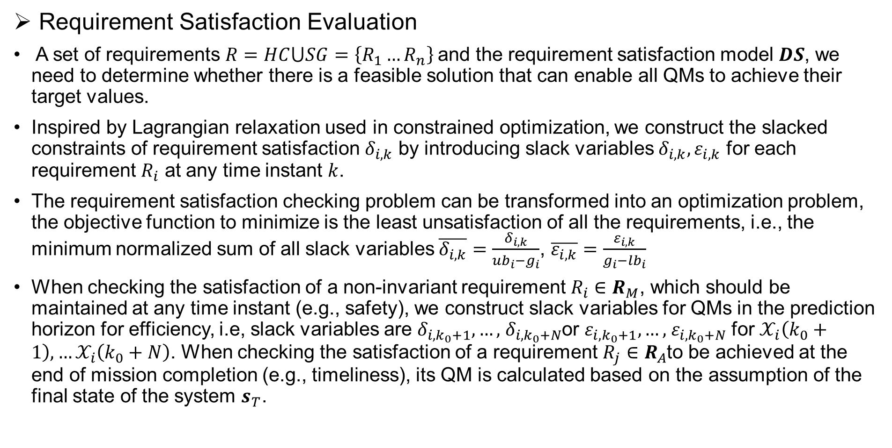
Autonomous Planning
Requirement Satisfaction Evaluation
A set of requirements $R=HC⋃SG=\left\{R_{1}…R_{n}\right\}$and the requirement satisfaction model $DS$, we need to determine whether there is a feasible solution that can enable all QMs to achieve their target values.
Inspired by Lagrangian relaxation used in constrained optimization, we construct the slacked constraints of requirement satisfaction $δ_{i,k}$ by introducing slack variables $δ_{i,k},ε_{i,k}$ for each requirement $R_{i}$ at any time instant $k$.
The requirement satisfaction checking problem can be transformed into an optimization problem, the objective function to minimize is the least unsatisfaction of all the requirements, i.e., the minimum normalized sum of all slack variables $\overline{δ_{i,k}}=\frac{δ_{i,k}}{{ub}_{i}−g_{i}}$, $\overline{ε_{i,k}}=\frac{ε_{i,k}}{g_{i}−{lb}_{i}}$
When checking the satisfaction of a non-invariant requirement $R_{i}∈R_{M}$, which should be maintained at any time instant (e.g., safety), we construct slack variables for QMs in the prediction horizon for efficiency, i.e, slack variables are $δ_{i,k_{0}+1},…,$ $δ_{i,k_{0}+N}$or $ε_{i,k_{0}+1},…,$ $ε_{i,k_{0}+N}$ for $𝒳_{i}\left(k_{0}+1\right),…𝒳_{i}\left(k_{0}+N\right)$. When checking the satisfaction of a requirement $R_{j}∈R_{A}$to be achieved at the end of mission completion (e.g., timeliness), its QM is calculated based on the assumption of the final state of the system $s_{T}$.

Slide 18

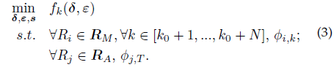
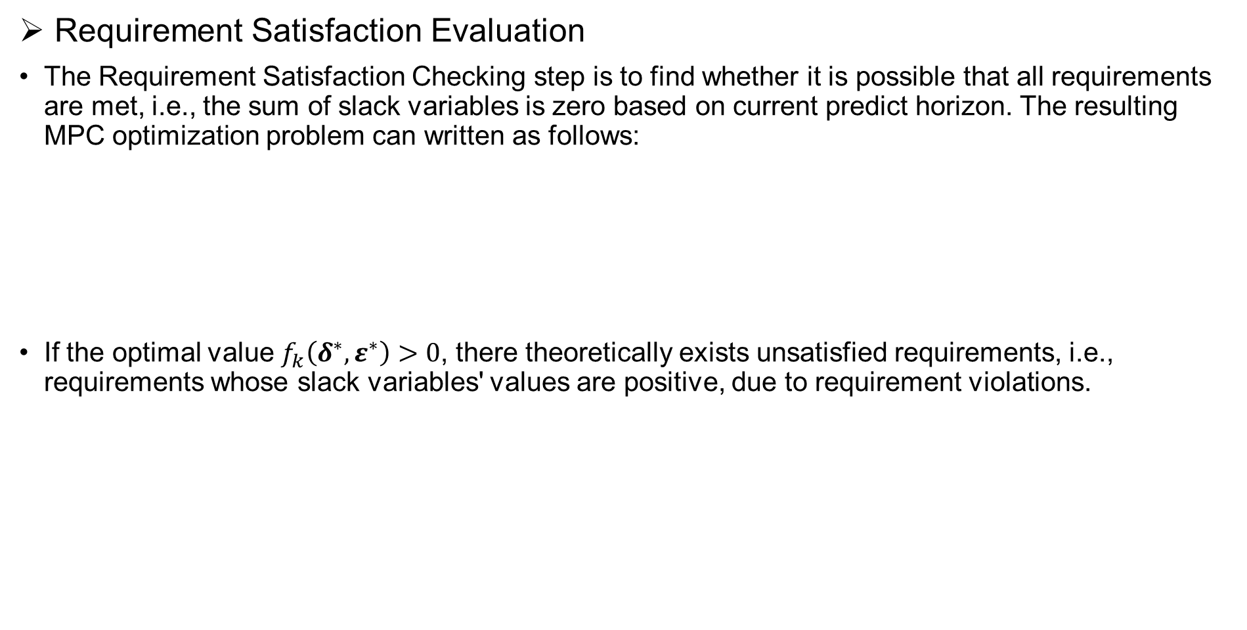
Autonomous Planning
Requirement Satisfaction Evaluation
The Requirement Satisfaction Checking step is to find whether it is possible that all requirements are met, i.e., the sum of slack variables is zero based on current predict horizon. The resulting MPC optimization problem can written as follows:
If the optimal value $f_{k}\left(δ^{∗},ε^{∗}\right)>0$, there theoretically exists unsatisfied requirements, i.e., requirements whose slack variables' values are positive, due to requirement violations.
With the expectation of finding the minimum violation for all requirements and the least adaptation effort in some scenarios, such a planning result could be used directly. We also compare the results of this method (named GSlack) in simulations.

Slide 19
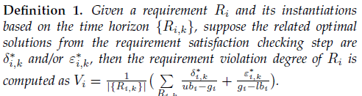
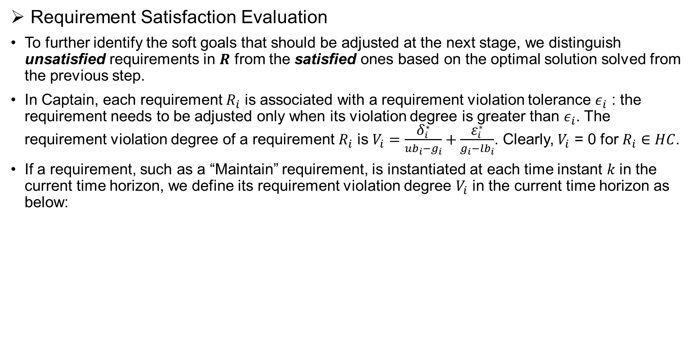
Autonomous Planning
Requirement Satisfaction Evaluation
To further identify the soft goals that should be adjusted at the next stage, we distinguish unsatisfied requirements in $R$ from the satisfied ones based on the optimal solution solved from the previous step.
In Captain, each requirement $R_{i}$ is associated with a requirement violation tolerance ${\text{ε}}_{i}$ : the requirement needs to be adjusted only when its violation degree is greater than ${\text{ε}}_{i}$. The requirement violation degree of a requirement $R_{i}$ is $V_{i}=\frac{{\text{δ}}_{i}^{∗}}{{ub}_{i}−g_{i}}+\frac{{\text{ε}}_{i}^{∗}}{g_{i}−{lb}_{i}}$. Clearly, $V_{i}$ = 0 for $R_{i}∈HC$.
If a requirement, such as a “Maintain” requirement, is instantiated at each time instant 𝑘 in the current time horizon, we define its requirement violation degree $V_{i}$ in the current time horizon as below:

Slide 20
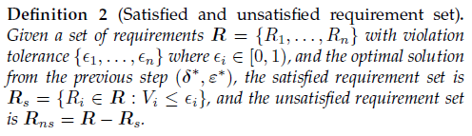
Autonomous Planning
Based on Definition 2, all of the hard constraints should belong to the satisfied requirement set, otherwise, there is a failure. The selection of unsatisfied requirements depends on violation tolerances. The tolerances can be decided based on user preference or experimental trials.

Slide 21

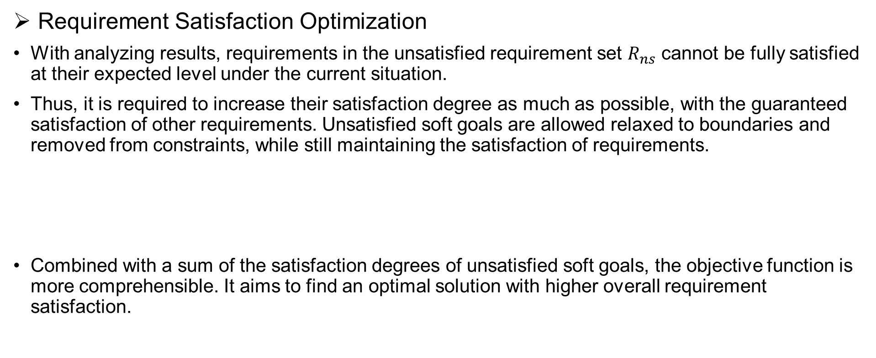
Autonomous Planning
Requirement Satisfaction Optimization
With analyzing results, requirements in the unsatisfied requirement set $R_{ns}$ cannot be fully satisfied at their expected level under the current situation.
Thus, it is required to increase their satisfaction degree as much as possible, with the guaranteed satisfaction of other requirements. Unsatisfied soft goals are allowed relaxed to boundaries and removed from constraints, while still maintaining the satisfaction of requirements.
Combined with a sum of the satisfaction degrees of unsatisfied soft goals, the objective function is more comprehensible. It aims to find an optimal solution with higher overall requirement satisfaction.

Slide 22
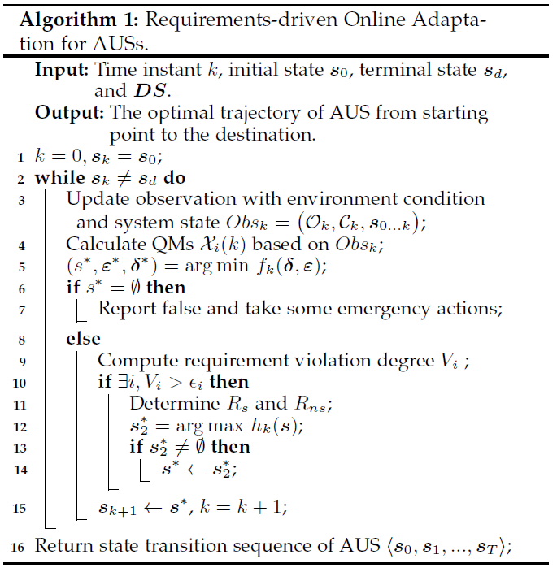
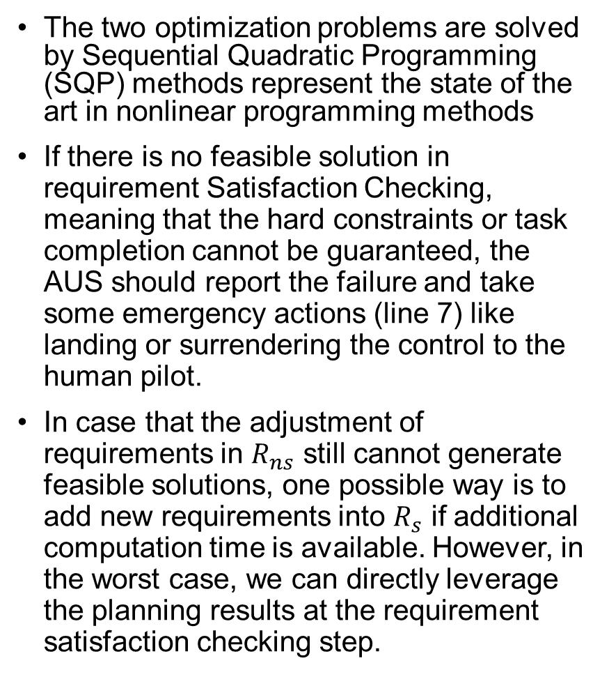
Algorithm
The two optimization problems are solved by Sequential Quadratic Programming (SQP) methods represent the state of the art in nonlinear programming methods
If there is no feasible solution in requirement Satisfaction Checking, meaning that the hard constraints or task completion cannot be guaranteed, the AUS should report the failure and take some emergency actions (line 7) like landing or surrendering the control to the human pilot.
In case that the adjustment of requirements in $R_{ns}$ still cannot generate feasible solutions, one possible way is to add new requirements into $R_{s}$ if additional computation time is available. However, in the worst case, we can directly leverage the planning results at the requirement satisfaction checking step.

Slide 23
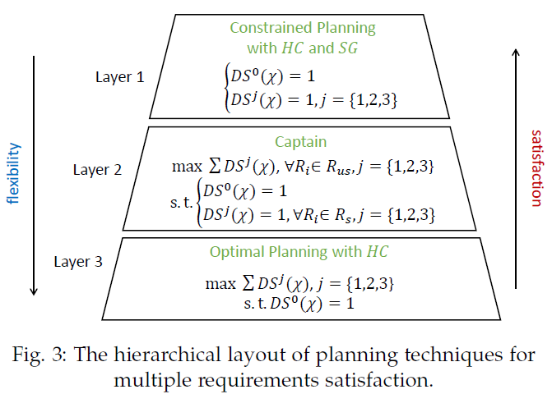
Features of Captain
Optimality: Captain achieves a balance between flexibility and satisfactory by selecting violated soft goals to be optimized while keeping the other satisfied requirements in their original formulation.
Flexibility: Captain is flexible to be compatible with other control-based methods. Such flexibility ensures the applicability of Captain in more situations with multiple requirements.
Proactive detection of requirement violations: Infeasibility of Eq. 5 implies violation of hard constraints or task failures.
Guaranteed real-time performance: The prediction horizon can be tuned according to the computational capability of the system.

Slide 24
4
Implementation in
UAV delivery scenario

Slide 25
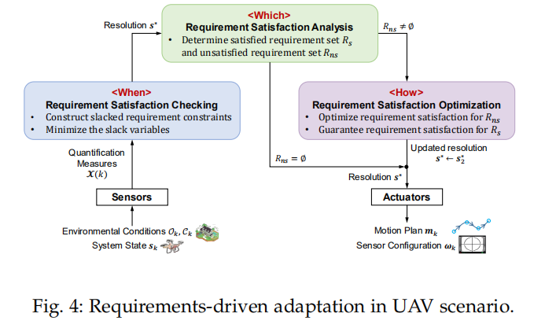
Overview

Slide 26
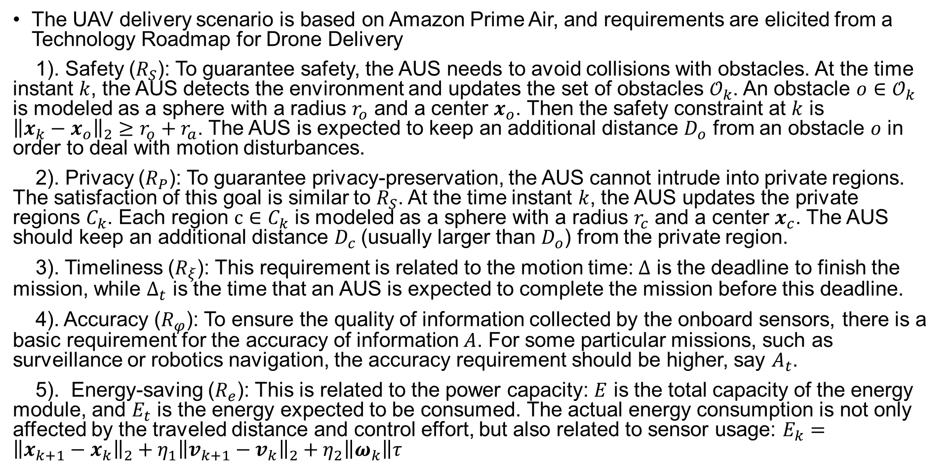
Requirement Modeling
The UAV delivery scenario is based on Amazon Prime Air, and requirements are elicited from a Technology Roadmap for Drone Delivery
1). Safety ($R_{S}$): To guarantee safety, the AUS needs to avoid collisions with obstacles. At the time instant $k$, the AUS detects the environment and updates the set of obstacles $𝒪_{k}$. An obstacle $o{∈𝒪}_{k}$ is modeled as a sphere with a radius $r_{o}$ and a center $x_{o}$. Then the safety constraint at $k$ is ${\left\|{x_{k}−x}_{o}\right\|}_{2}≥r_{o}+r_{a}$. The AUS is expected to keep an additional distance $D_{o}$ from an obstacle $o$ in order to deal with motion disturbances.
2). Privacy ($R_{P}$): To guarantee privacy-preservation, the AUS cannot intrude into private regions. The satisfaction of this goal is similar to $R_{S}$. At the time instant $k$, the AUS updates the private regions $C_{k}$. Each region $c{∈C}_{k}$ is modeled as a sphere with a radius $r_{c}$ and a center $x_{c}$. The AUS should keep an additional distance $D_{c}$(usually larger than $D_{o}$) from the private region.
3). Timeliness ($R_{ξ}$): This requirement is related to the motion time: $Δ$ is the deadline to finish the mission, while $Δ_{t}$ is the time that an AUS is expected to complete the mission before this deadline.
4). Accuracy ($R_{φ}$): To ensure the quality of information collected by the onboard sensors, there is a basic requirement for the accuracy of information $A$. For some particular missions, such as surveillance or robotics navigation, the accuracy requirement should be higher, say $A_{t}$.
5). Energy-saving ($R_{e}$): This is related to the power capacity: $E$ is the total capacity of the energy module, and $E_{t}$ is the energy expected to be consumed. The actual energy consumption is not only affected by the traveled distance and control effort, but also related to sensor usage: $E_{k}={\left\|{x_{k+1}−x}_{k}\right\|}_{2}+η_{1}{\left\|{v_{k+1}−v}_{k}\right\|}_{2}+η_{2}\left\|ω_{k}\right\|τ$

Slide 27
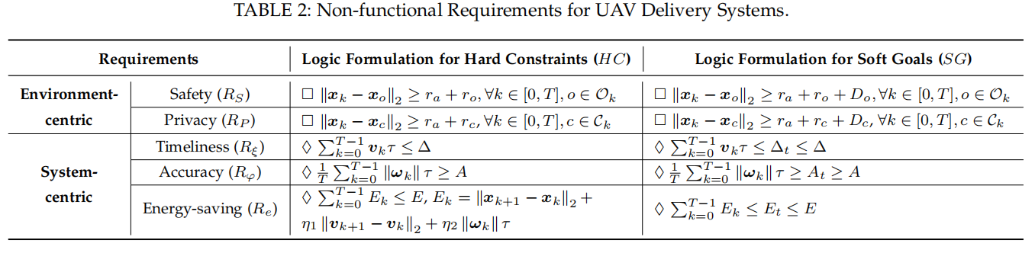
Requirement Modeling

Slide 28
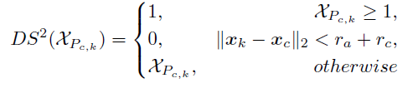
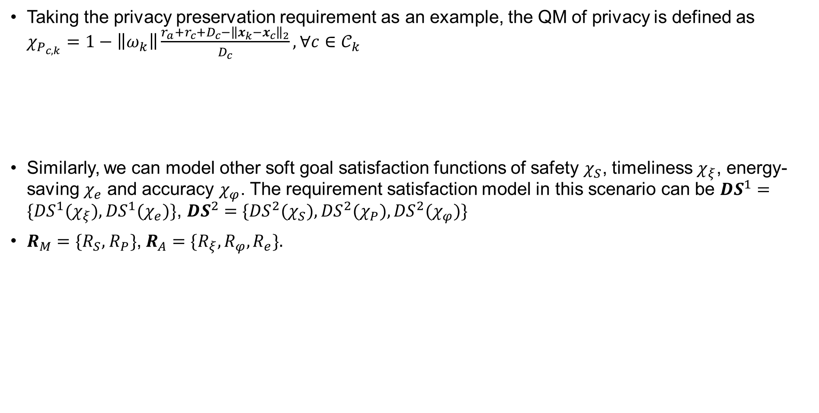
Requirement Satisfaction Modeling
Taking the privacy preservation requirement as an example, the QM of privacy is defined as $χ_{P_{c,k}}=1−\left\|ω_{k}\right\|\frac{r_{a}+r_{c}+D_{c}−{\left\|{x_{k}−x}_{c}\right\|}_{2}}{D_{c}},∀c∈𝒞_{k}$
Similarly, we can model other soft goal satisfaction functions of safety $χ_{S}$, timeliness $χ_{ξ}$, energy-saving $χ_{e}$ and accuracy $χ_{φ}$. The requirement satisfaction model in this scenario can be ${DS}^{1}=\{{DS}^{1}(χ_{ξ}),{DS}^{1}(χ_{e})\}$, ${DS}^{2}=\{{DS}^{2}(χ_{S}),{DS}^{2}(χ_{P}),{DS}^{2}(χ_{φ})\}$
$R_{M}=\{R_{S},$ $R_{P}\}$, $R_{A}=\{R_{ξ},R_{φ},R_{e}\}.$

Slide 29

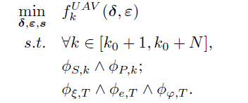

Requirement Satisfaction Evaluation
Suppose the sensing range is 𝑙 in the sense that only the obstacles and private regions whose distances to the UAV are not larger than 𝑙 can be detected. At the current instant $k_{0}$, the UAV needs to plan its motions 𝒎 and sensor configuration 𝝎 for the following consecutive 𝑁 time steps, where $N≤\left\lfloor \frac{l}{v_{max}τ}\right\rfloor$

Slide 30
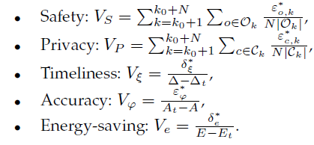

Requirement Satisfaction Evaluation
After the above step, we get the planning results, i.e., vectors for all slack variables $(δ^{∗},ε^{∗})$. Then the calculations of violation degree for safety, privacy, timeliness, accuracy and energy-saving are: In this scenario, the calculations of violation degree for different requirements are listed as follows:

Slide 31
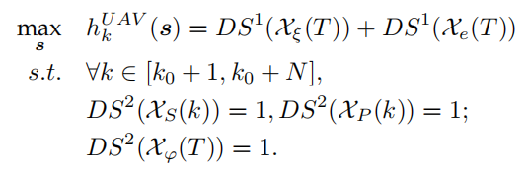
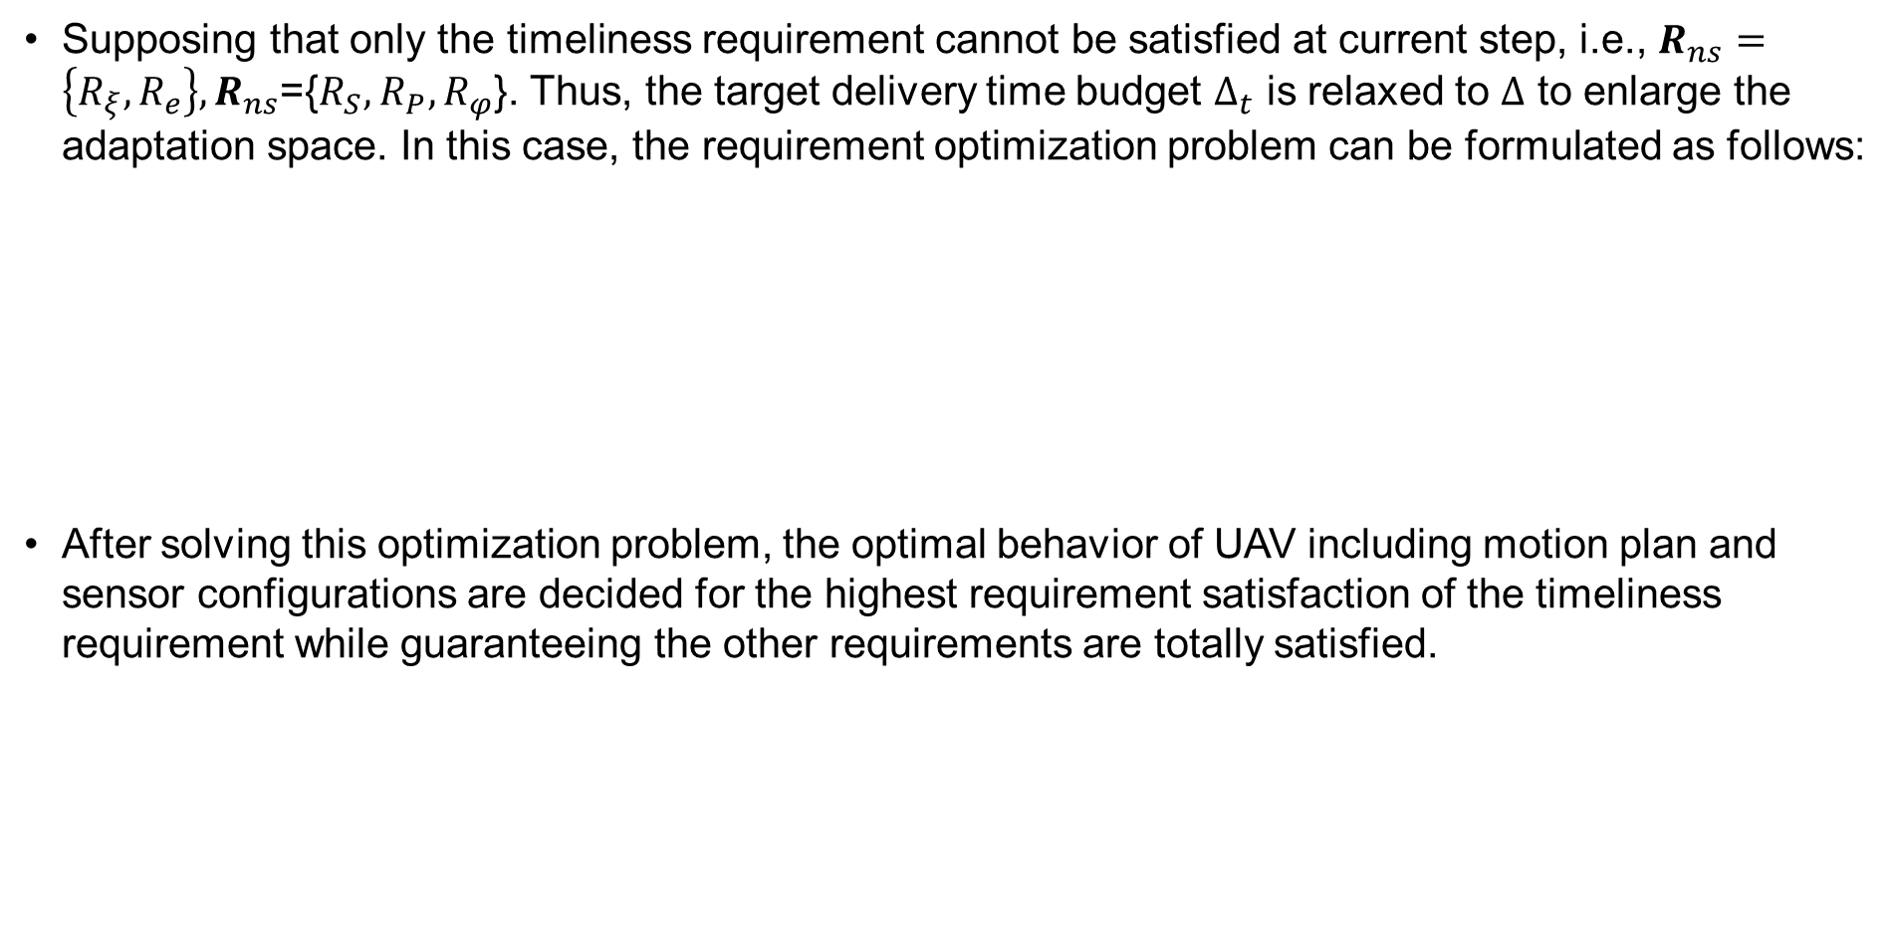
Requirement Satisfaction Optimization
Supposing that only the timeliness requirement cannot be satisfied at current step, i.e., $R_{ns}=\left\{R_{ξ},R_{e}\right\},R_{ns}$={$R_{S},$ $R_{P},R_{φ}$}. Thus, the target delivery time budget $Δ_{t}$ is relaxed to $Δ$ to enlarge the adaptation space. In this case, the requirement optimization problem can be formulated as follows:
After solving this optimization problem, the optimal behavior of UAV including motion plan and sensor configurations are decided for the highest requirement satisfaction of the timeliness requirement while guaranteeing the other requirements are totally satisfied.

Slide 32
5
Experimental Evaluation

Slide 33
Experimental Evaluation
We evaluated Captain in two AUS scenarios using MATLAB, and also implemented it on a real UAV (DJI Matrice 100). We evaluated the effectiveness, robustness, scalability and real-time performance of Captain. Our experiments focus on the following questions:
RQ1. (Effectiveness): Can Captain detect and mitigate requirement unsatisfaction, and provide optimal adaptation solutions at runtime?
RQ2. (Robustness): Can Captain handle different types of disturbances at runtime?
RQ3. (Scalability): Can Captain be generalized to different environment scales and different application scenarios?
RQ5. (Real-time Performance): Is the real-time performance of Captain acceptable with the respect of overhead?

Slide 34
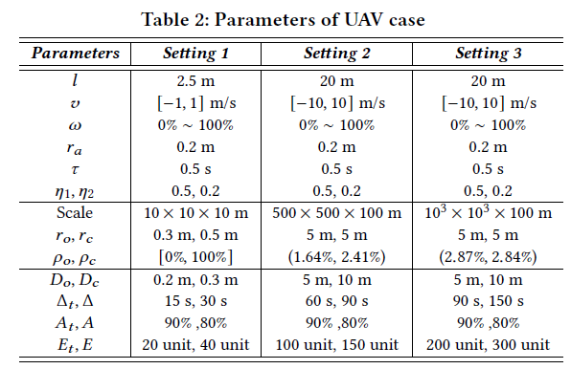
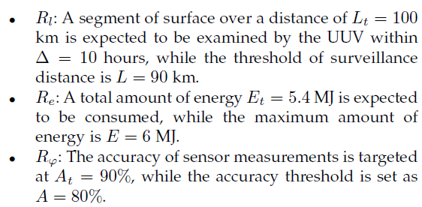
Evaluation Scenarios and Setup
For simulation, we implemented a simulator based on MATLAB 2019b on a desktop equipped with Intel(R) Core(TM) i7-7700U CPU@3.60GHz and 32GB RAM. The constructed optimization problems are solved by the Optimization Toolbox of MATLAB. Captain is compared with AMOCS-MA, the state-of-the-art control-based adaptation method for multiple software requirements. We also compared the results of Captain with those from the Requirement Satisfaction Checking, which only considers the minimization of requirement violation of all soft goals. We denoted the latter one as GSlack.
UAV Delivery Scenario
UUV Oceanic Surveillance
DJI Matrice 100 UAV Scenario

Slide 35
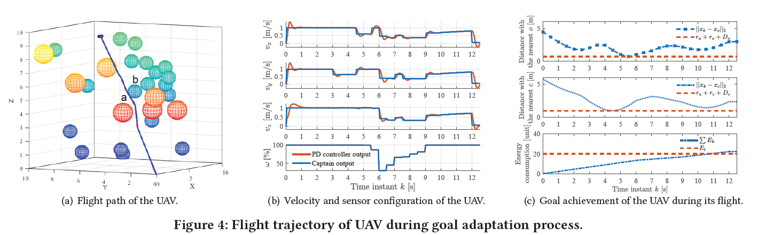
RQ1. Effectiveness
UAV case

Slide 36
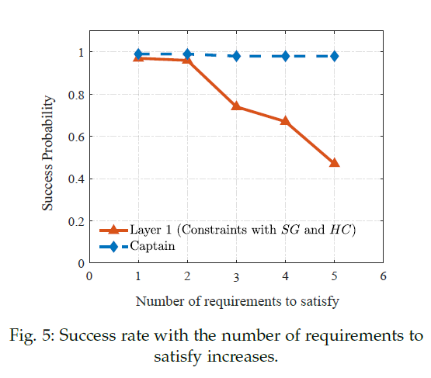
RQ1. Effectiveness
UAV case
Based on AUS models, Captain is effective in planning proper and optimal adaptation solutions at runtime to detect and mitigate requirement unsatisfaction.

Slide 37
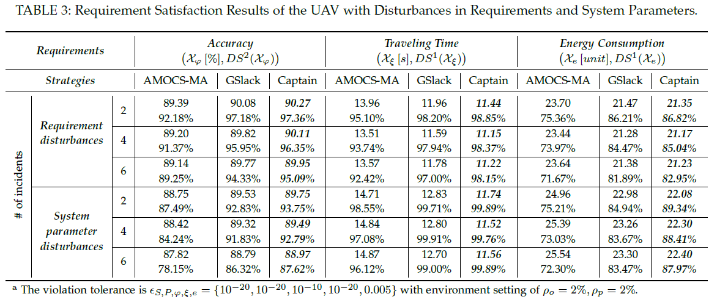
RQ2. Robustness
UAV case

Slide 38
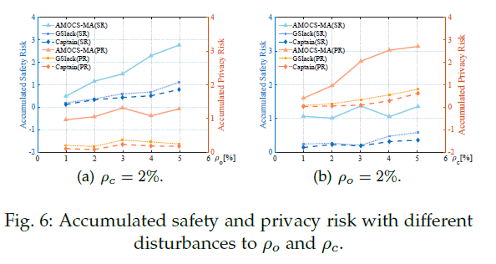
RQ2. Robustness
UAV case
Captain can handle environment-centric requirements effectively, and is also robust against other types of disturbances including sensor failures and requirement variations, guaranteeing better performance in requirement satisfaction.

Slide 39
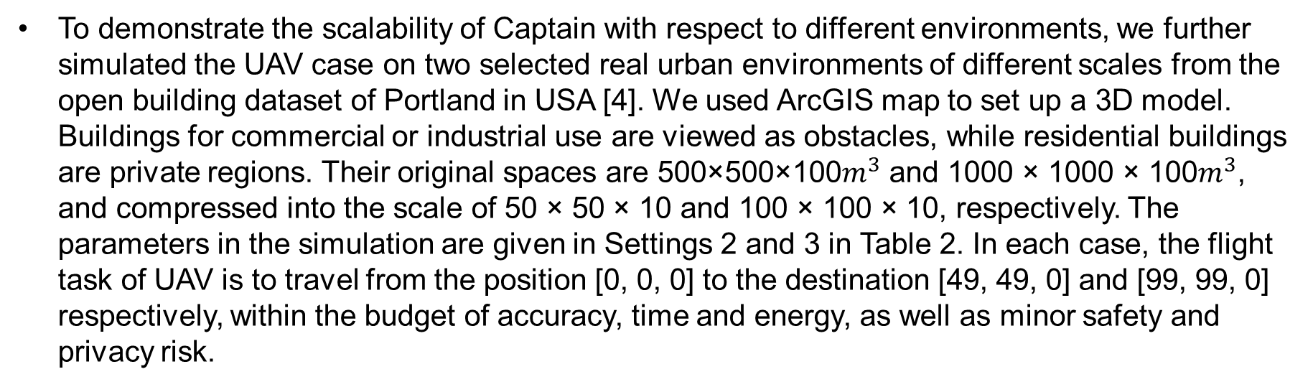
RQ3. Scalability
To demonstrate the scalability of Captain with respect to different environments, we further simulated the UAV case on two selected real urban environments of different scales from the open building dataset of Portland in USA [4]. We used ArcGIS map to set up a 3D model. Buildings for commercial or industrial use are viewed as obstacles, while residential buildings are private regions. Their original spaces are 500×500×100$m^{3}$ and 1000 × 1000 × 100$m^{3}$, and compressed into the scale of 50 × 50 × 10 and 100 × 100 × 10, respectively. The parameters in the simulation are given in Settings 2 and 3 in Table 2. In each case, the flight task of UAV is to travel from the position [0, 0, 0] to the destination [49, 49, 0] and [99, 99, 0] respectively, within the budget of accuracy, time and energy, as well as minor safety and privacy risk.

Slide 40
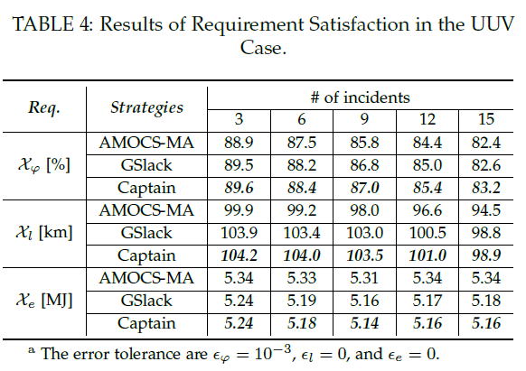
RQ3. Scalability
Generality with UUV case
Captain is scalable in different real urban scenarios and can be generalized into other AUS applications..

Slide 41
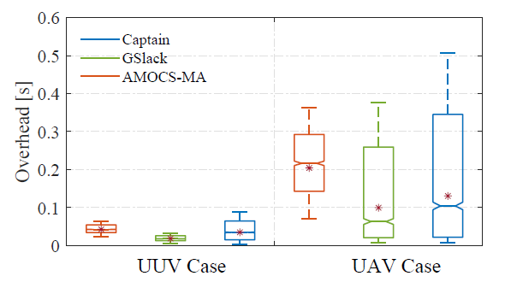
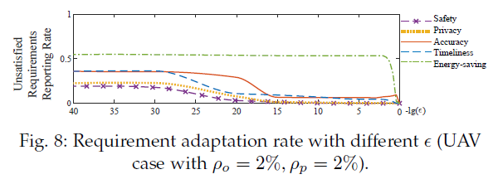
RQ4. Runtime Overhead
the gap of average computation time between AMOCS-MA and Captain is about 7 ms (0.0423 s versus 0.0344 s) in the UUV case, and 70 ms (0.2039 s versus 0.1301 s) in the UAV case. This is because AMOCS-MA considers the optimization of all requirements while Captain only considers the determined unsatisfied requirements. So AMOCS-MA requires more computations especially when there are more requirements to be considered.
Captain incurs acceptable computation overhead and is suitable for AUS in handling multiple requirements simultaneously online.

Slide 42
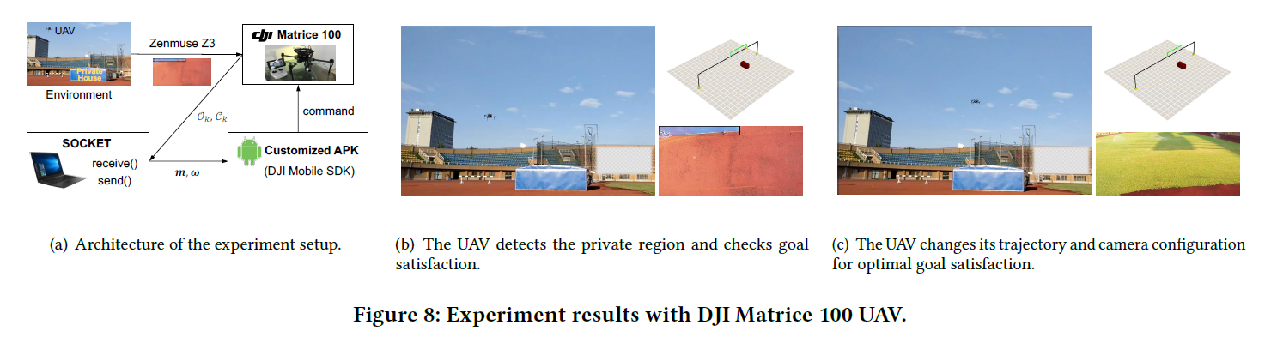
Implementation on a Real UAV
Captain is deployed on a Lenovo laptop which can receive the environment contexts from the onboard camera and generate the optimal motion plan. Then the optimal motion plan is sent to the DJI Matrice 100 via the Android application developed with the DJI mobile SDK on a mobile phone.
More details of experiments can be found at: https://fse2020captain.github.io/.

Slide 43
Threats to Validity
Construct validity
Internal validity
Captain requires that requirements can be assessed or quantified, which may not be easy for all attributes.
More evaluations of different AUSs with more requirements are needed to validate Captain in the future.
The main limitation of the optimal control is that the convergent speed is sensitive to frequent changes and the initial values set to solve the problem.
In the future, we plan to try machine learning methods to generate high-quality initial solutions.
External validity
There are other uncertainties (e.g., weather, human in-the-loop) that can affect Captain and make the requirement satisfaction models more complex.
We plan to evaluate Captain under scenarios with more types of uncertainties.

Slide 44
Limitation and Potential Mitigation
Choice of violation tolerances
Choice of optimization methods
The selection of unsatisfied requirements in Captain is dependent on the violation tolerances The values cannot be too high either, otherwise it would filter a lower number of requirements and result in no feasible solution again in the following optimization step. In experiments, we had to determine these values through trial-and-error.
There is a risk that the solution falls into a local optimum for SQP optimizer
Revised SQP method, heuristic algorithms for global optimum
Choice of prediction horizons
Considering that some qualities of AUS software may not change drastically (e.g., energy consumption), they are not required to be checked frequently
A two-layer hierarchical MPC approach. The first layer utilizes long discrete time steps and is used to monitor requirements with slowly changing attributes (energy consumption), while the second layer utilizes short discrete time steps and is used to monitor requirements with more frequently changing attributes (e.g., safety).

Slide 45
6
Related Work

Slide 46
Models at Runtime
Existing methods
The basic underlying motivation for runtime models is the need for managing the complexity that arises from the large amounts of information that can be associated with runtime phenomena. Runtime models provide abstractions of the system and its requirements serving as a driver and enabler for automatic reasoning about system adaptations during operation.
Different techniques for reasoning and planning have been proposed can be generally classified into two types of adaptation models: rule-based and search-based.
Limits
they only consider functional requirements reflecting functions of the underlying system and non-functional requirements reflecting quality properties of the system related to some functionality, e.g., the reliability of a service.
suffers from scalability issues as the number of rules to managed and validated increases, and from costly reasoning and planning processes
In Captain, we set up the non-functional requirement model from the perspective of both environment and system in the AUS applications. It provides an efficient and effective way to reason about adaptations in environments that are highly open and dynamic.

Slide 47
Requirements-Driven Self-Adaptation
Existing methods
In the wave goal-driven adaptation, the textual language RELAX is invented to express requirements in terms of uncertainty[6], and incorporated into goal models for self-adaptive system using KAOS[7].
AutoRELAX[8] targets at figure out the relaxed goal model at the least number of relaxed goals and adaptation cost online. A similar approach introduces FLAGS[9] for mitigating requirements uncertainty by extending goal model with adaptive goals, allowing requirements to be partially satisfied and the system possesses the ability of fault tolerance.
Limits
Mostly specify and deal with the functional and/or non-functional requirements form the perspective of the system, defined as the missions to complete and the performance of the system
With a established requirement model, e.g., goal model, as the knowledge base of adaptation, these methods also presume a predefined adaptation space.
In our approach, we also elicit and model the non-functional requirements for AUSs to met from the perspective of their operating environment. The alternatives are automatically generated in our approach.

Slide 48
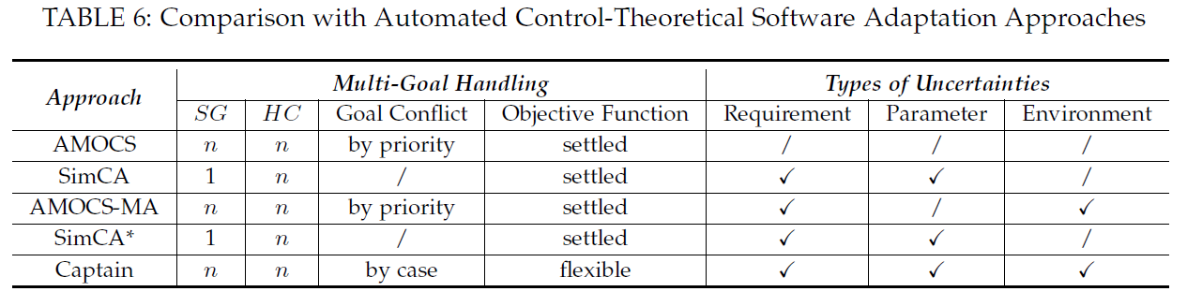
Control-Based Self-Adaptation
Existing methods
Strategies for the design of a control theoretical adaptive system have been proposed since the Push-Button Methodology (PBM) [12] —— single goal
Multiple goals are satisfied through a system of cascaded controllers[13] —— preference, sub-optimal solutions
SimCA[2] and its variants SimCA* [14]—— cannot handling conflicting goals
AMOCS-MA[1] —— low real-time performance
Captain optimizes overall satisfaction multiple goals, which may conflict with others, in the premise of the guarantees of hard constraints and task completion.

Slide 49
7
Conclusions and Future work

Slide 50
Conclusions and Future work
Conclusions
We present a novel control-based approach, Captain, to dynamically adjusting multiple and conflicting goals for AUSs.
It enables AUSs to respond to changes of environmental conditions, requirements and system parameters at real-time.
The effectiveness and efficiency of Captain are evaluated on two kinds of simulation scenarios and a real UAV.
Experiments show that Captain outperforms the state-of-art controlled based self-adaptive methods with higher flexibility, optimality and lower overhead.
Future work
study methods to further improve the efficiency of violated goal identification and reduce the failure rate at the Goal Satisfaction Optimization step.
handle more complex scenarios of AUSs with additional requirements.

Slide 51
Reference
Maggio M, Papadopoulos A V, Filieri A, et al. Automated control of multiple software goals using multiple actuators[C]//Proceedings of the 2017 11th joint meeting on foundations of software engineering. ACM, 2017: 373-384.
Shevtsov S, Weyns D. Keep it simplex: Satisfying multiple goals with guarantees in control-based self-adaptive systems[C]//Proceedings of the 2016 24th ACM SIGSOFT International Symposium on Foundations of Software Engineering. ACM, 2016: 229-241.
Ramirez A J, Cheng B H C. Automatic derivation of utility functions for monitoring software requirements[C]//International Conference on Model Driven Engineering Languages and Systems. Springer, Berlin, Heidelberg, 2011: 501-516.
Knauss A, Damian D, Franch X, et al. ACon: A learning-based approach to deal with uncertainty in contextual requirements at runtime[J]. Information and software technology, 2016, 70: 85-99.
Vierhauser M, Cleland-Huang J, Bayley S, et al. Monitoring cps at runtime-a case study in the uav domain[C]//2018 44th Euromicro Conference on Software Engineering and Advanced Applications (SEAA). IEEE, 2018: 73-80.
Whittle J, Sawyer P, Bencomo N, et al. RELAX: a language to address uncertainty in self-adaptive systems requirement[J]. Requirements Engineering, 2010, 15(2): 177-196.
Whittle J, Sawyer P, Bencomo N, et al. Relax: Incorporating uncertainty into the specification of self-adaptive systems[C]//2009 17th IEEE International Requirements Engineering Conference. IEEE, 2009: 79-88.
Fredericks E M, DeVries B, Cheng B H C. AutoRELAX: automatically RELAXing a goal model to address uncertainty[J]. Empirical Software Engineering, 2014, 19(5): 1466-1501.
Baresi L, Pasquale L, Spoletini P. Fuzzy goals for requirements-driven adaptation[C]//2010 18th IEEE International Requirements Engineering Conference. IEEE, 2010: 125-134.
Degiovanni R, Ricci N, Alrajeh D, et al. Goal-conflict detection based on temporal satisfiability checking[C]//Proceedings of the 31st IEEE/ACM International Conference on Automated Software Engineering. ACM, 2016: 507-518.
Degiovanni R, Castro P, Arroyo M, et al. Goal-conflict likelihood assessment based on model counting[C]//2018 IEEE/ACM 40th International Conference on Software Engineering (ICSE). IEEE, 2018: 1125-1135.

Slide 52
Reference
Filieri A, Hoffmann H, Maggio M. Automated design of self-adaptive software with control-theoretical formal guarantees[C]//Proceedings of the 36th International Conference on Software Engineering. ACM, 2014: 299-310.
Filieri A, Hoffmann H, Maggio M. Automated multi-objective control for self-adaptive software design[C]//Proceedings of the 2015 10th Joint Meeting on Foundations of Software Engineering. ACM, 2015: 13-24.
Shevtsov S, Weyns D, Maggio M. SimCA*: A control-theoretic approach to handle uncertainty in self-adaptive systems with guarantees[J]. ACM Transactions on Autonomous and Adaptive Systems (TAAS), 2019, 13(4): 17.

